Slide 1
SATURDAY
MEAL
SERVICE
For Food Service Managers

Slide 2
CDE APPROVED
Saturday breakfast and lunch meal services are pre-approved by the CDE for all main sites and off-sites.
Implementation can begin once the Request to Begin or Change Saturday Meal Service is completed and approved by the Food Services Division.

Slide 3
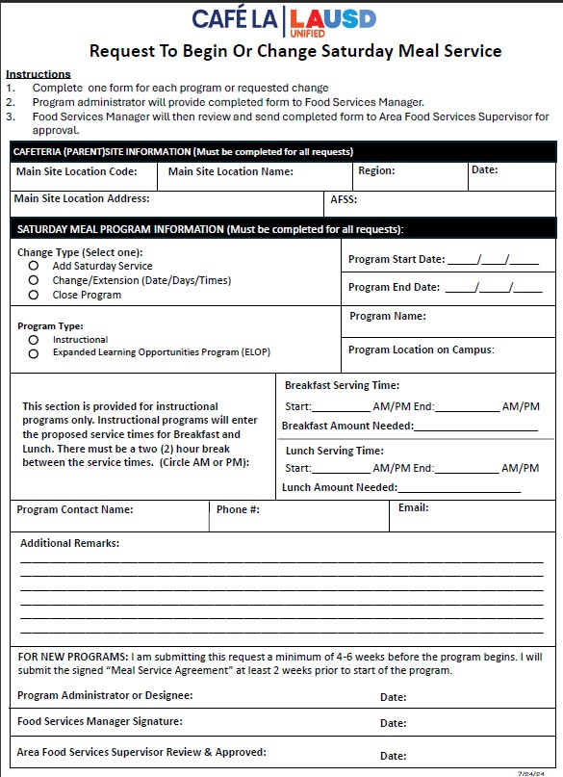
REQUEST TO BEGIN OR CHANGE SATURDAY MEAL SERVICE
A Request to Begin or Change Saturday Meal Service form must be completed before the start of any Saturday program on site.
Must be submitted 4-6 weeks before program start date.
Once completed by the program administrator, form must be signed by the Area Food Services Supervisor for approval.

Slide 4
TYPES OF SATURDAY PROGRAMS
Saturday Meal Service can be classified into two different programs on campus
CACFP
(Supper Only)
Expanded Learning Opportunity Program (ELOP)
NSLP
(Breakfast and Lunch)
Instructional

Slide 5
FOLLOW THE RIGHT GUIDELINES
This training will cover all guidelines for Instructional Saturday Programs under NSLP receiving both breakfast and lunch meals.
All Enrichment and Expanded Learning Opportunities Programs (ELOP), will follow all supper guidelines. Please refer to the Supper Program training for additional information.

Slide 6
Mandatory Postings
The following forms and posters must be posted in an area visible by the general public for NSLP Instructional Saturday Programs:
Current Health Inspection Report
Current “And Justice For All”
Saturday Service Menu

Slide 7
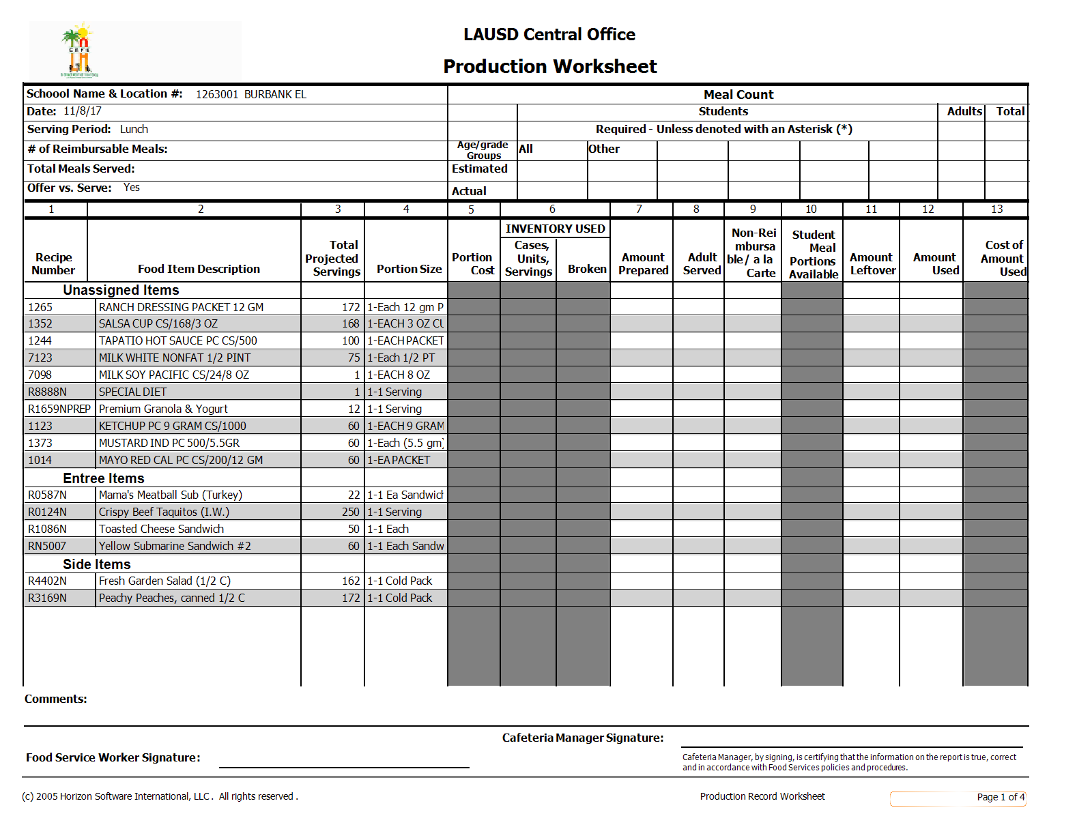
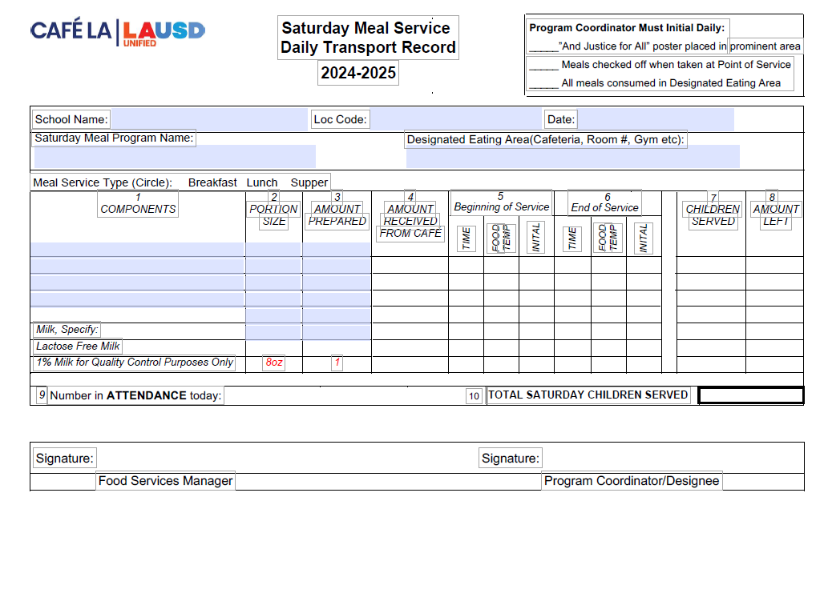
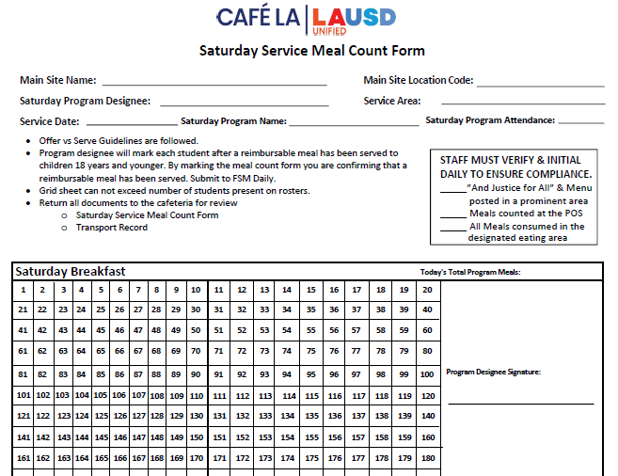
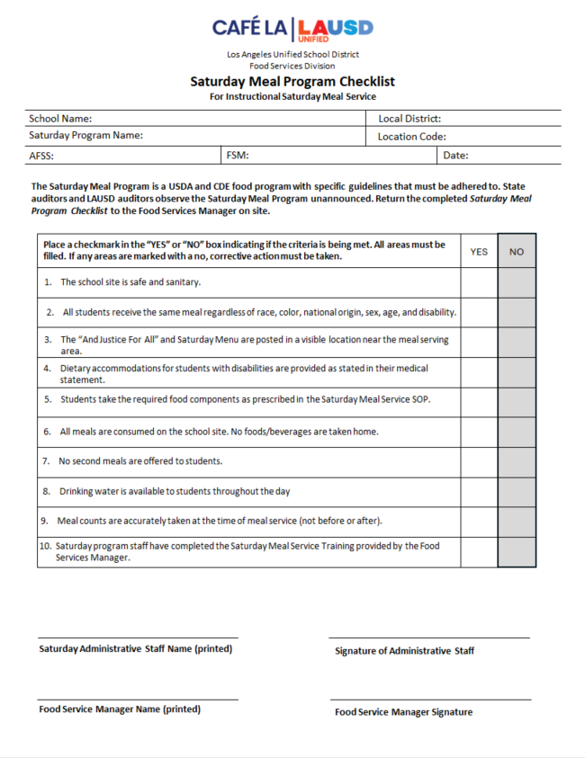
1
2
Saturday Meal Service Required Forms
Production Record
Daily Meal Transport Record
3
4
Saturday Meal Count form
Saturday Meal Service Checklist

Slide 8
Saturday Meal Service Checklist
The Saturday Meal Service Checklist is used to ensure Saturday meals are served in compliance to CDE guidelines.
Check list must be completed within the first 4 weeks of the Saturday program by the Saturday program administration.

Slide 9
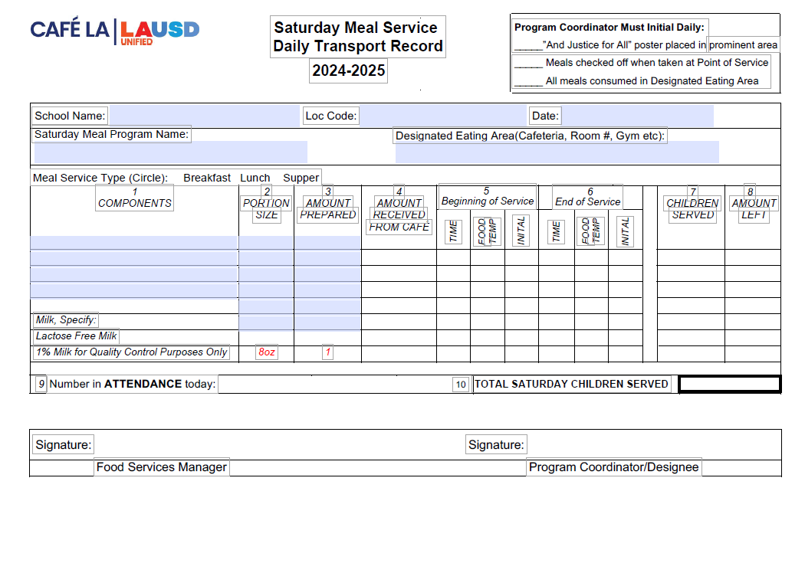
SATURDAY DAILY TRANSPORT RECORD
Saturday transport record is used whenever food is being served outside of FSD hands.
Once service has completed Saturday Program staff will record the total attendance and total children served reimbursable meals
Once received Saturday Program staff will then fill amount received, temp each item at the beginning and end of service. Document children served and the amount leftoever.
FSM will pre-fill components portion size, amount prepared and circle the meal service received.
FSM will pre-fill the header with school name, location code, date, ect.
Before returning Daily Transport Record, Saturday program staff will sign. Verifying all information is true and correct.
FSM will sign once record is returned. Signifying all fields have been properly filled.

Slide 10
SATURDAY SERVICE MEAL COUNT FORM
FSM will supply Saturday Program staff with the Saturday Service Meal Count Form along with the Saturday Daily Transport Record to be completed for breakfast and lunch service.

Slide 11
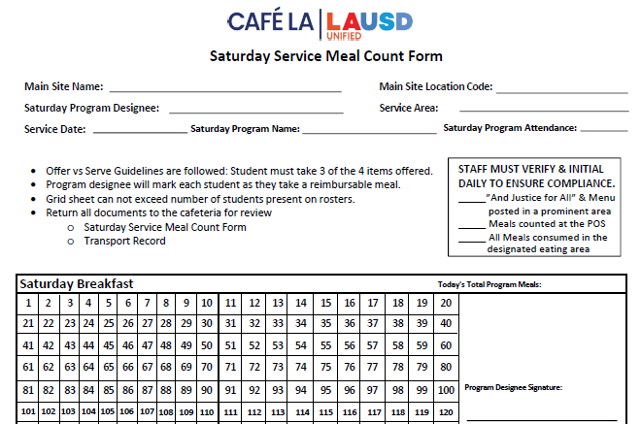
SATURDAY SERVICE MEAL COUNT REPORT
continued
Saturday Program Staff will then mark off each student as they receive a reimbursable meal on the grid portion of the form.
Once service has ended. Saturday Program Staff will record the total number of reimbursable meals served and sign.
FSM will complete the portion for main site, name, and the location code in the header before providing Saturday program staff with the form.
Number of meals received must not exceed the amount of attendance.
Saturday program staff will complete remaining portions of header.

Slide 12
HACCP Guidelines
Saturday Program Staff is required to follow all HACCP guidelines.
Food Service Manager will leave Saturday Service Menu items in an accessible refrigerator unit for Saturday program staff
Three(3) clean, sanitized, and calibrated thermometers will be provided by the Food Services Manager to Saturday Program Staff along with sanitation wipes.
ALL potentially hazardous items, hot and cold, must be temped and recorded onto the Daily Transport Record.
The Food Service Manager will add one carton of milk for temperature-taking purposes.

Slide 13
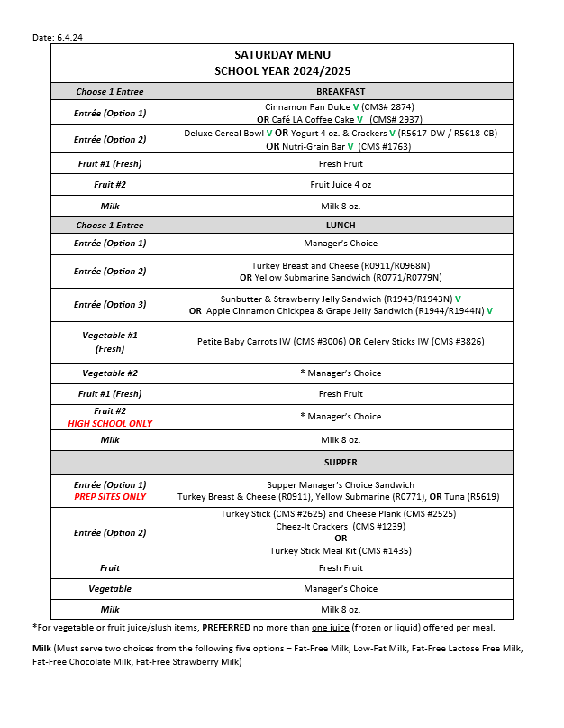
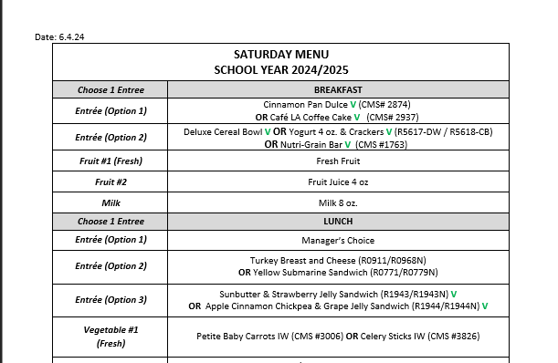
MENU AT A GLANCE
The Saturday Recovery Menu can be found on the FSD webpage under the Menu tab.
Once the FSM has chosen an Entrée Option. They will then choose a popular option they would like to serve. For instance:
Only ONE Entrée must be served for Breakfast and Lunch
FSM will choose from the entrée options provided on the Saturday Recovery Menu for Saturday service.
OR
OR
Deluxe Cereal Bowl
Yogurt & Crackers
Nutri-grain Bar
DO NOT SERVE ALL OPTIONS

Slide 14
OFFER VS SERVE
In an effort to reduce waste all instructional Saturday programs will follow Offer vs Serve guidelines for all meal services:
Saturday Breakfast
Student must take 3 or more points; one must be a fruit.
Saturday Lunch
Student must take 3 components
One component MUST be a fruit or vegetable.

Slide 15
Saturday Breakfast Service

Slide 16
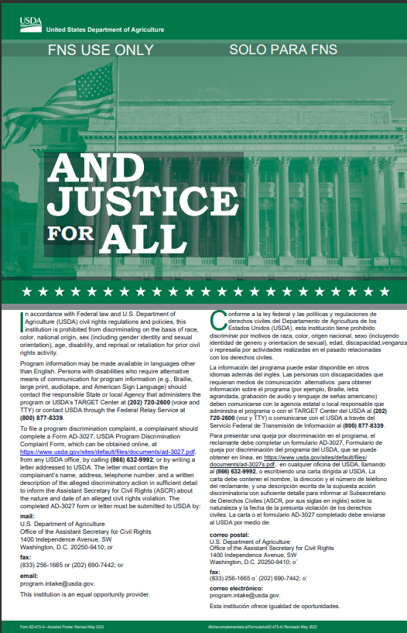
Saturday
Breakfast
Meal Service
Set-Up
And they can always take another food item
Main Item is 2 points
Students must take a total of 3 points
Fruit juice is 1 point
+
+
1 point
2 points
1 point

Slide 17
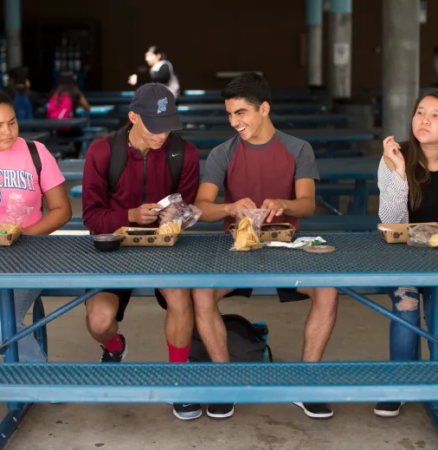
Saturday Lunch Service

Slide 18
Saturday
Lunch
Reimbursable Meals
1 item must be a
Fruit or Vegetable
Student must take 3 items
Take a Milk if you like
Notes:
This model allows for OVS

Slide 19
After Service Overview

Slide 20
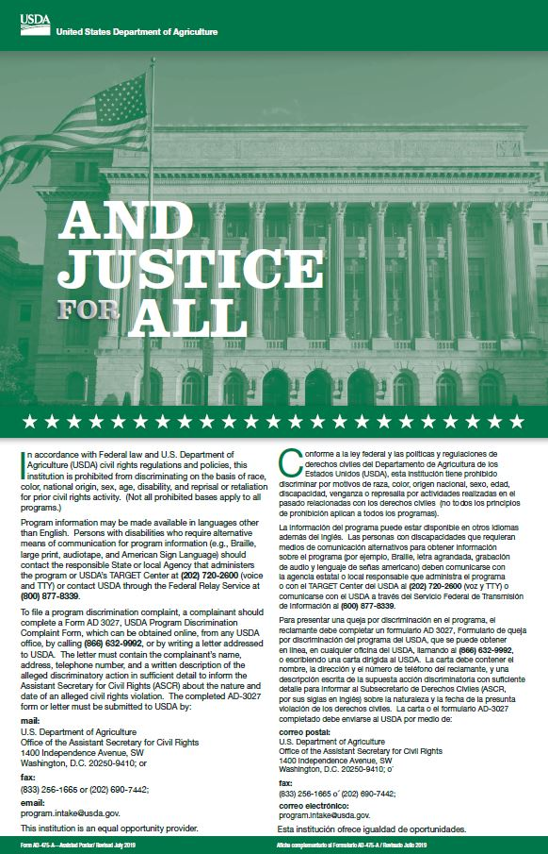
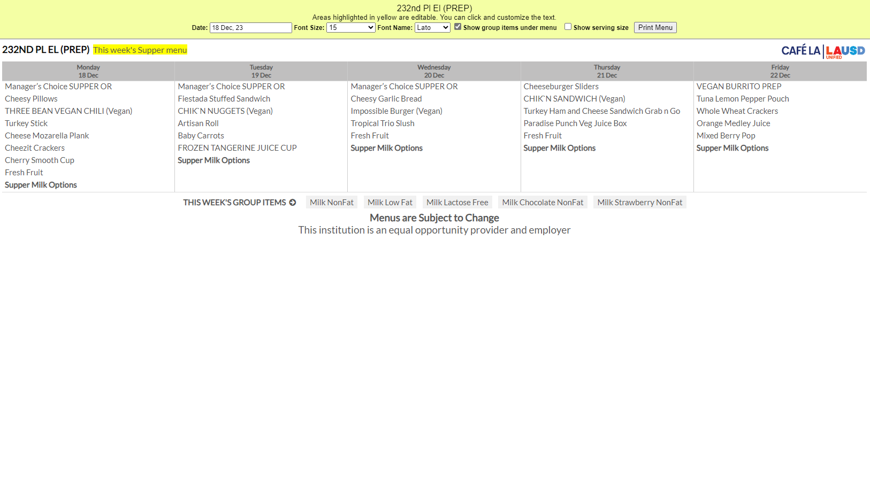
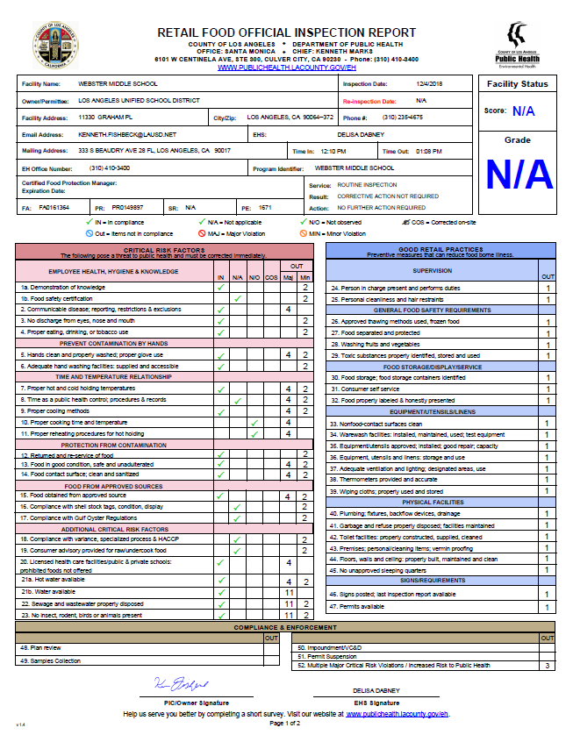
Saturday Program staff will leave all left over items in the designated refrigeration unit for pick up on the following Monday
Only whole untampered with fruits and non-perishable items will be returned to stock.
All other items will be discarded
Return to Stock
Discard

Slide 21
Once I’ve discarded all perishable items. I can now enter my productions and daily entry.
Queen Bee designs

Slide 22
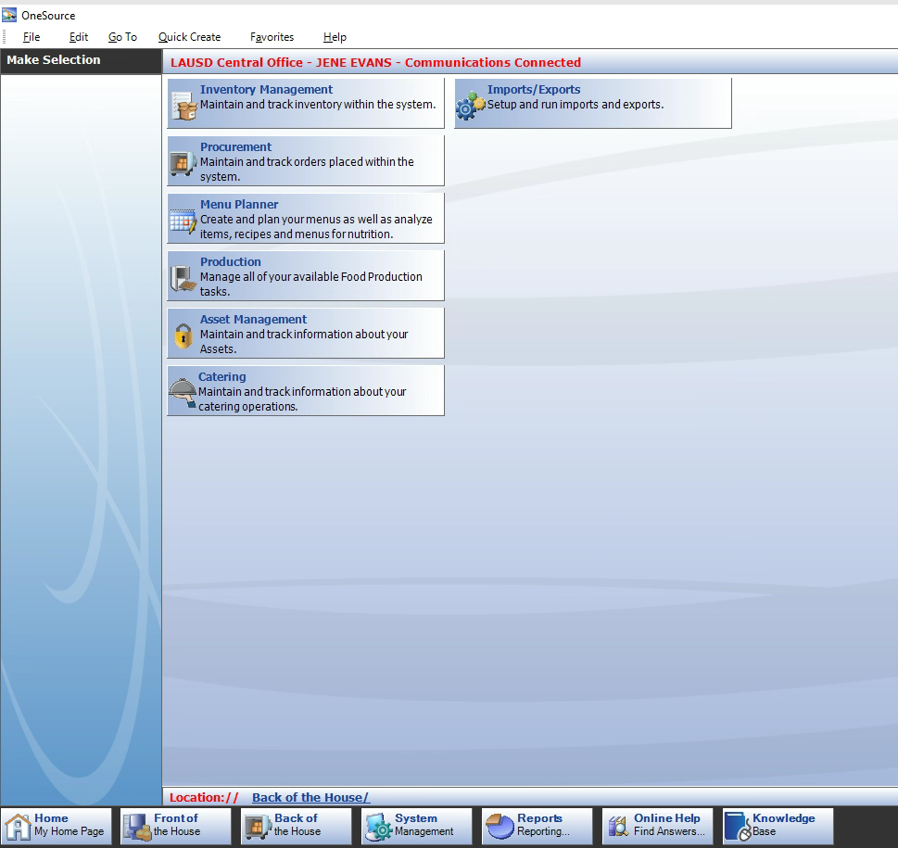
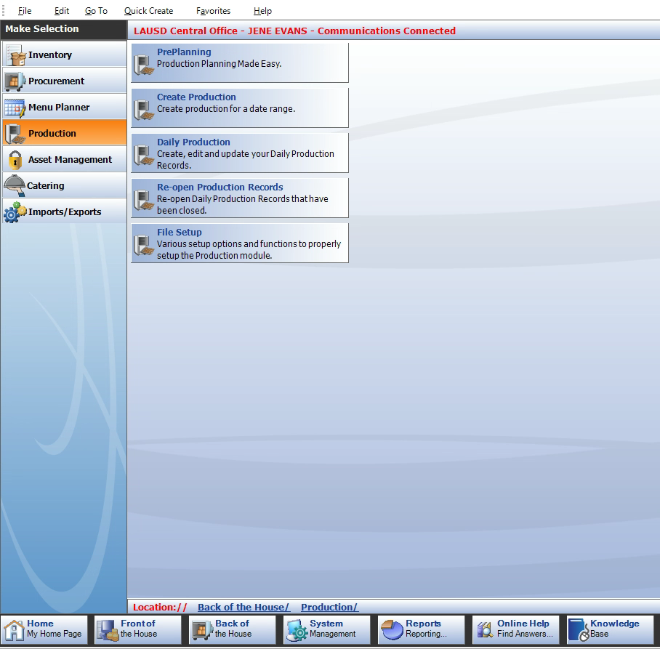
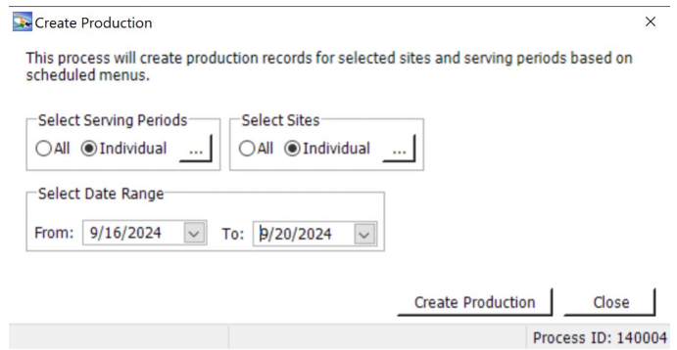
Creating Saturday Productions
Production Records must be created for all Saturday Programs and all serving periods under main site.
Go to Back of House.
Click Productions.
Click Create Productions.
Next in the “select serving periods” area click individual, then select the serving period to create.
Then in the “ select site” area click individual, then choose the main site.
Select the date you would like to create.
Finally select Create Productions to create the Saturday productions for the site.

Slide 23
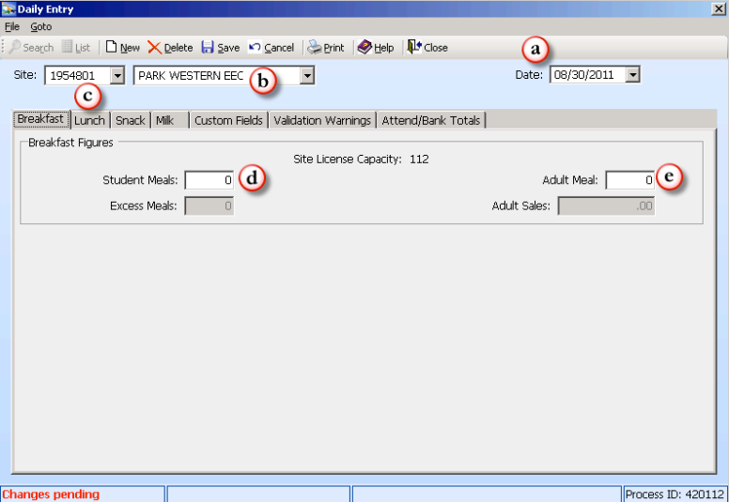
ENTERING MEALS IN CMS
The following Monday after Saturday Meal Service, the Food Service Manager will enter all meal counts into CMS as a Daily Entry under Main Site.

Slide 24
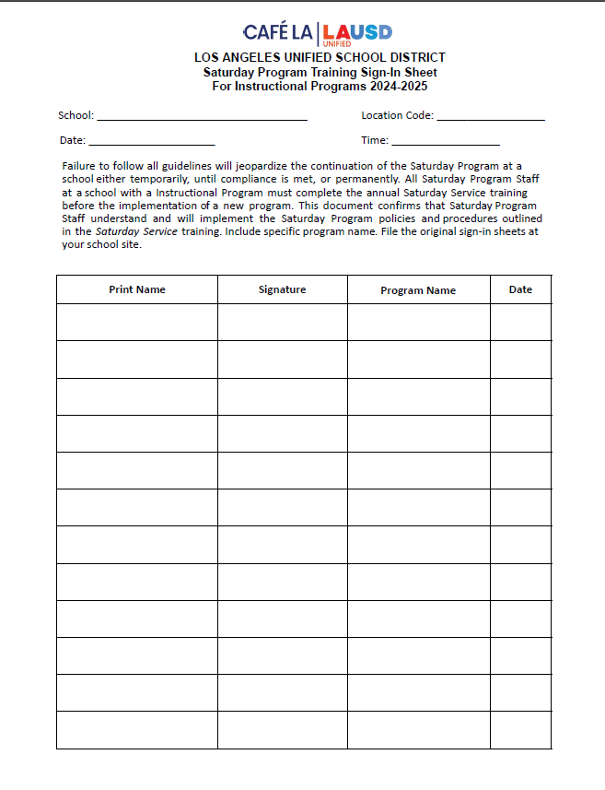
Saturday Program Training Verification Forms
FSD is required to provide annual Saturday Program training to Food Service Managers and Saturday Program staff before the implementation of a new program.
Instructional Programs will sign the Saturday Program Training Sign-in sheet after the completion of this training.

Slide 25
Summary
To recap this training has covered:
Program Rules.
Saturday Productions
Saturday Grid Sheets.
Identifying Reimbursable Meals.
Saturday Meal Service Compliant Checklist
CMS accountability

